Slide 1

DESIGN AND ANALYSIS OF ALGORITHMS (113939)
Dr. Owais Hussain

Slide 2

Agenda
Dynamic Programming Strategy
Fibonacci Series (again)
Primer Numbers
Recap: Graphs
Commute in Karachi
Exercise
0/1 Knapsack Problem
DIY

Slide 3
Sample 2
Dynamic Programming
Dynamic Programming is an algorithm design strategy used to solve optimization problems through a sequence of sub-problems.
Like Greedy technique, it solves a sequence of steps to reach the solution.
The main theme is to store each solution in memory, so that it can be reused when solving next stage of the problem.
In backtracking, we prune non-promising solutions; in dynamic programming, we avoid re-computation.
Particularly effective for problems that are recursive in nature.
Trades additional storage cost for high efficiency.

Slide 4
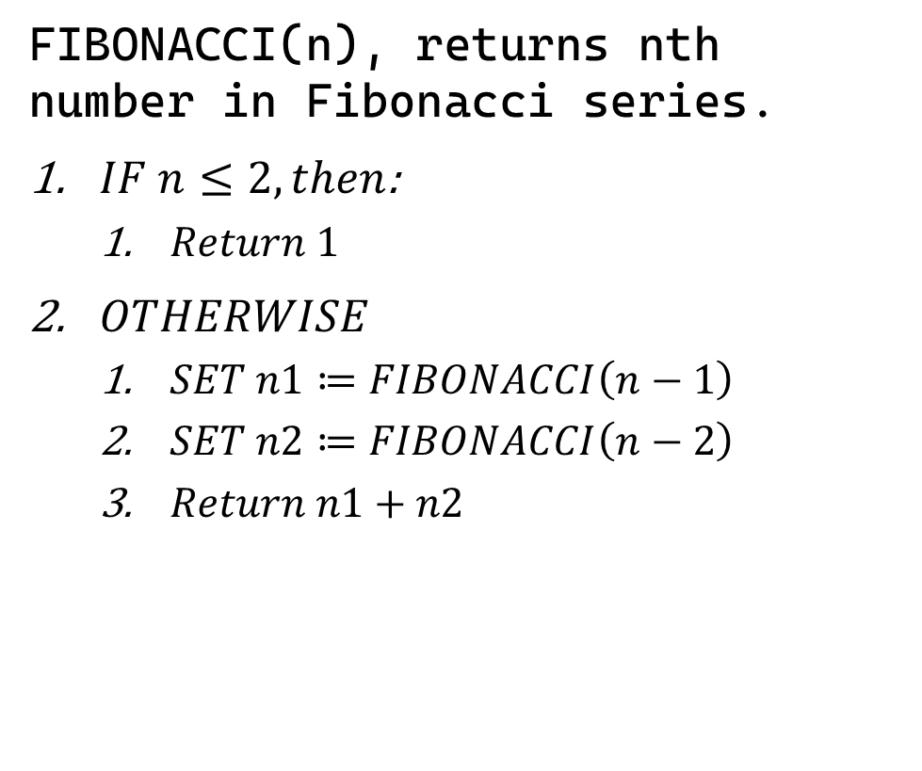
Sample 2
Fibonacci Series (again)
FIBONACCI(n), returns nth number in Fibonacci series.
$IF n≤2, then$:
$Return 1$
$OTHERWISE$
$SET n1≔FIBONACCI\left(n−1\right)$
$SET n2≔FIBONACCI\left(n−2\right)$
$Return n1+n2$
Fib(4)
Fib(3)
Fib(2)
Fib(2)
Fib(1)
1
1
1
Fib(5)
Fib(3)
Fib(1)
1
Fib(2)
1

Slide 5
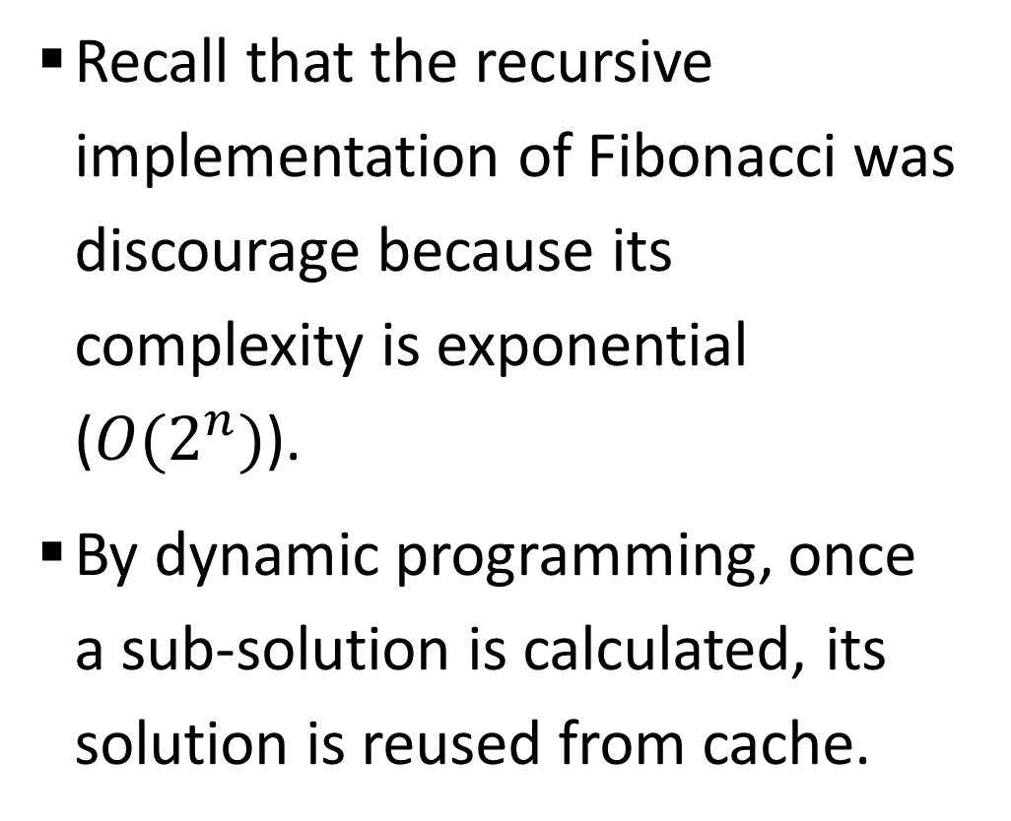
Sample 2
Fibonacci Series (again)
Recall that the recursive implementation of Fibonacci was discourage because its complexity is exponential ($O(2^{n})$).
By dynamic programming, once a sub-solution is calculated, its solution is reused from cache.
Fib(4)
Fib(3)
Fib(2)
Fib(2)
Fib(1)
1
1
Fib(5)
Fib(3)
Fib(1)
Fib(2)

Slide 6



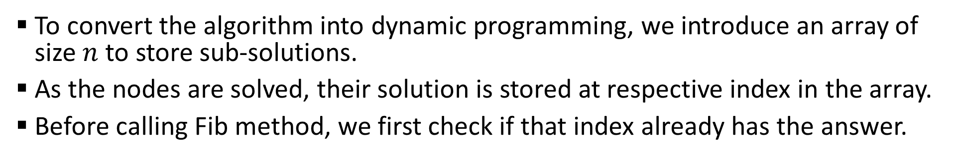






















Sample 2
Fibonacci Series (again)
To convert the algorithm into dynamic programming, we introduce an array of size $n$ to store sub-solutions.
As the nodes are solved, their solution is stored at respective index in the array.
Before calling Fib method, we first check if that index already has the answer.
Fib(4)
Fib(3)
Fib(2)
Fib(2)
Fib(1)
1
1
Fib(5)
Fib(3)
$$φ$$
$$φ$$
$$φ$$
$$φ$$
$$φ$$
$$1$$
$$φ$$
$$φ$$
$$φ$$
$$φ$$
$$1$$
$$1$$
$$2$$
$$φ$$
$$φ$$
$$1$$
$$1$$
$$2$$
$$3$$
$$φ$$
$$1$$
$$1$$
$$2$$
$$3$$
$$5$$

Slide 7
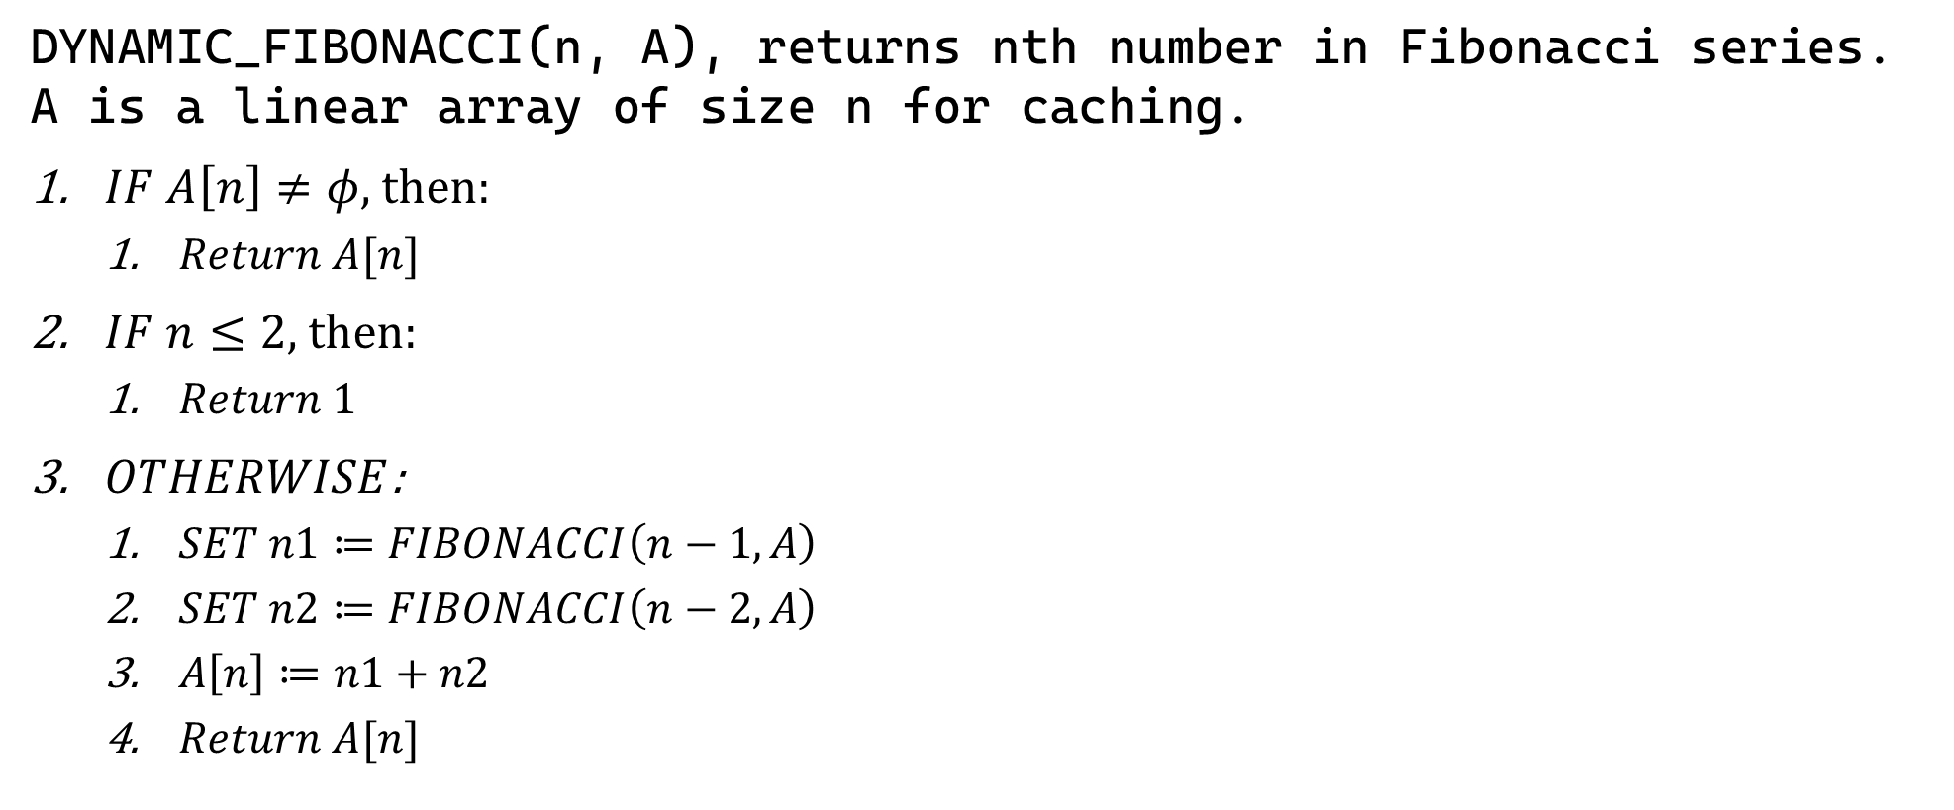
Sample 2
Fibonacci Series (again)
DYNAMIC_FIBONACCI(n, A), returns nth number in Fibonacci series. A is a linear array of size n for caching.
$IF A\left[n\right]≠φ$, then:
$Return A[n]$
$IF n≤2$, then:
$Return 1$
$OTHERWISE$:
$SET n1≔FIBONACCI\left(n−1, A\right)$
$SET n2≔FIBONACCI\left(n−2, A\right)$
$A\left[n\right]≔n1+n2$
$Return A[n]$

Slide 8
Sample 2
Analysis of Selection Sort
DEMO

Slide 9
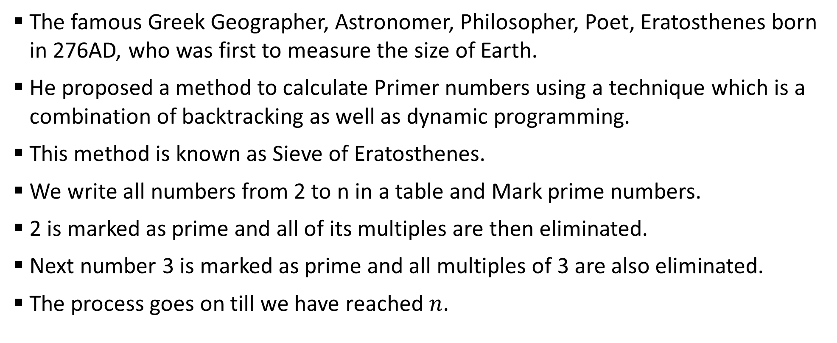
Sample 2
Prime Numbers
The famous Greek Geographer, Astronomer, Philosopher, Poet, Eratosthenes born in 276AD, who was first to measure the size of Earth.
He proposed a method to calculate Primer numbers using a technique which is a combination of backtracking as well as dynamic programming.
This method is known as Sieve of Eratosthenes.
We write all numbers from 2 to n in a table and Mark prime numbers.
2 is marked as prime and all of its multiples are then eliminated.
Next number 3 is marked as prime and all multiples of 3 are also eliminated.
The process goes on till we have reached $n$.

Slide 10
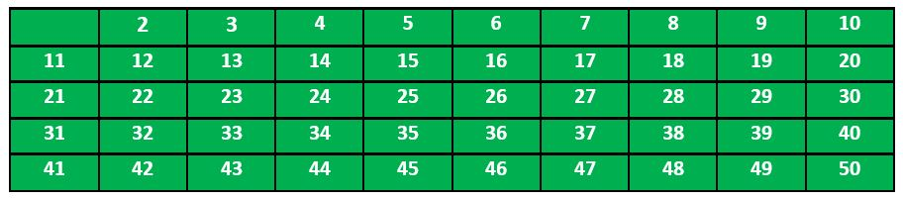
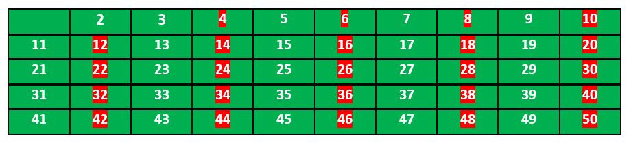
Sample 2
Prime Numbers

Slide 11
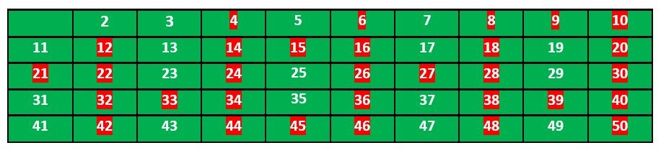
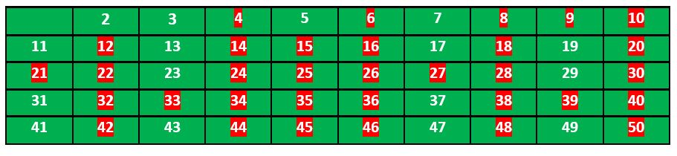
Sample 2
Prime Numbers

Slide 12
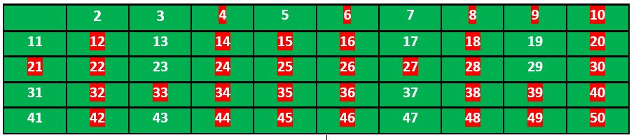
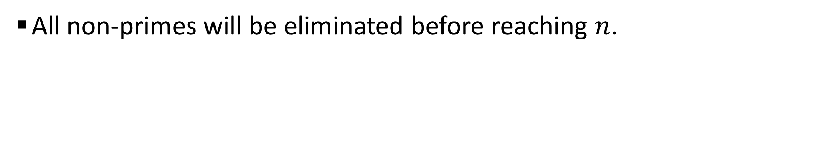
Sample 2
Prime Numbers
All non-primes will be eliminated before reaching $n$.
Notes:
Note! The screenshots were taken from GeeksForGeeks.org.

Slide 13
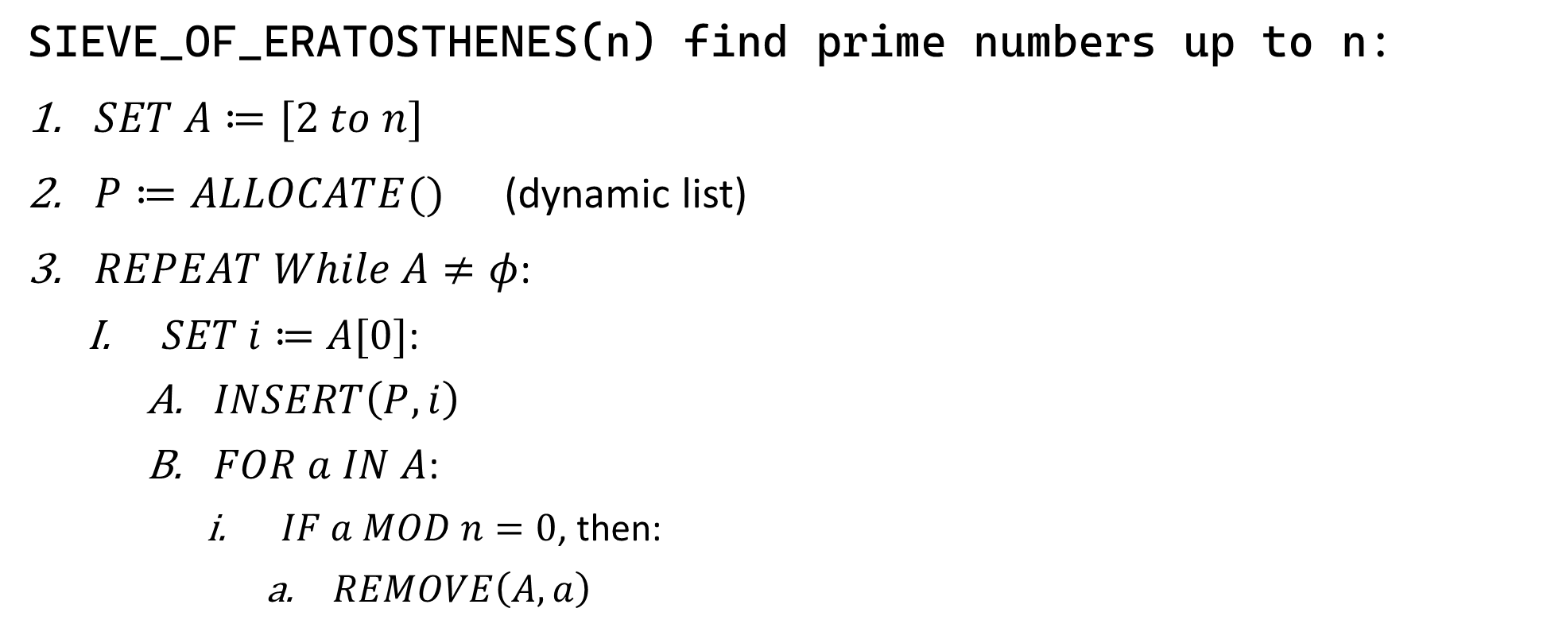
Sample 2
Prime Numbers
SIEVE_OF_ERATOSTHENES(n) find prime numbers up to n:
$SET A≔[2 to n]$
$P≔ALLOCATE()$ (dynamic list)
$REPEAT While A≠φ$:
$SET i≔A[0]$:
$INSERT\left(P, i\right)$
$FOR a IN A$:
$IF a MOD n=0$, then:
$REMOVE\left(A,a\right)$

Slide 14
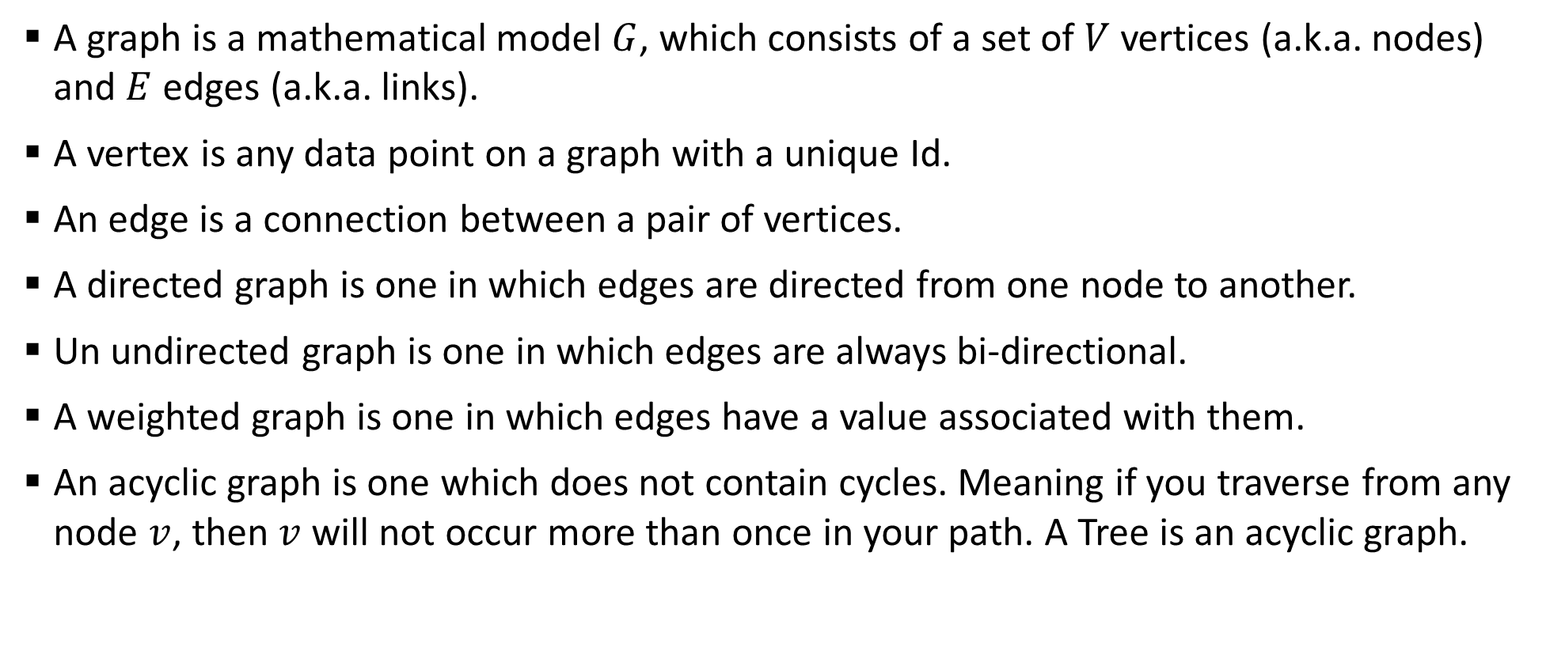
Sample 2
Recap: Graphs
A graph is a mathematical model $G$, which consists of a set of $V$ vertices (a.k.a. nodes) and $E$ edges (a.k.a. links).
A vertex is any data point on a graph with a unique Id.
An edge is a connection between a pair of vertices.
A directed graph is one in which edges are directed from one node to another.
Un undirected graph is one in which edges are always bi-directional.
A weighted graph is one in which edges have a value associated with them.
An acyclic graph is one which does not contain cycles. Meaning if you traverse from any node $v$, then $v$ will not occur more than once in your path. A Tree is an acyclic graph.

Slide 15
Sample 2
Recap: Graphs
A cyclic graph contains cycles. You can start traversing from a node, follow edges, and eventually return to the same node.
A path is a sequence of nodes where each adjacent pair is connected by an edge. The length of a path is the number of edges in it.
The shortest path between two nodes is the path with the minimum number of edges.
A graph can be represented as a 2D adjacency matrix.
A graph with nodes 1, 2, 3, and 4, and edges (1, 2), (1, 3), (2, 4), (3, 2), (4, 3) can be expressed as:
1 1 0 0 0 1 0 1 1 0 0 1 0 0 0 0 0 1 1 1

Slide 16
Sample 2
Commute in Karachi
The graph illustrates various paths you can take to reach Tower from Water pump roundabout.
Each stop takes an approximate amount of time to reach the other.
NIPA
18
Bahria Uni
6
Sh-e-Faisal
14
12
6
Water pump
20
3 Hatti
16
Saddar
12
Light house
8
Tower
10
7
5
17
6
Five Star
Lasbela
Soldier Bazar
Nanakwarra
16
10
8

Slide 17
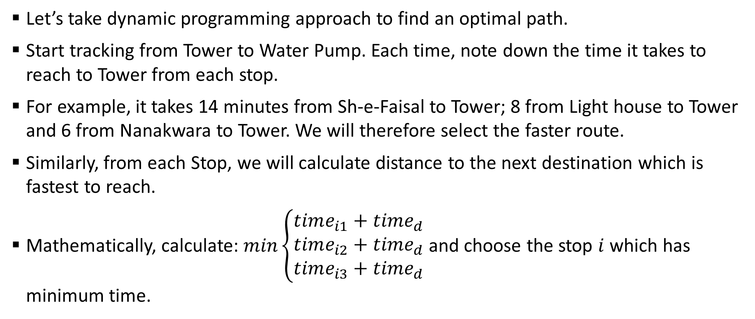
Sample 2
Commute in Karachi
Let’s take dynamic programming approach to find an optimal path.
Start tracking from Tower to Water Pump. Each time, note down the time it takes to reach to Tower from each stop.
For example, it takes 14 minutes from Sh-e-Faisal to Tower; 8 from Light house to Tower and 6 from Nanakwara to Tower. We will therefore select the faster route.
Similarly, from each Stop, we will calculate distance to the next destination which is fastest to reach.
Mathematically, calculate: $min\left\{\begin{aligned}time_{i1}+time_{d} \\ time_{i2}+time_{d} \\ time_{i3}+time_{d}\end{aligned}\right.$ and choose the stop $i$ which has minimum time.

Slide 18
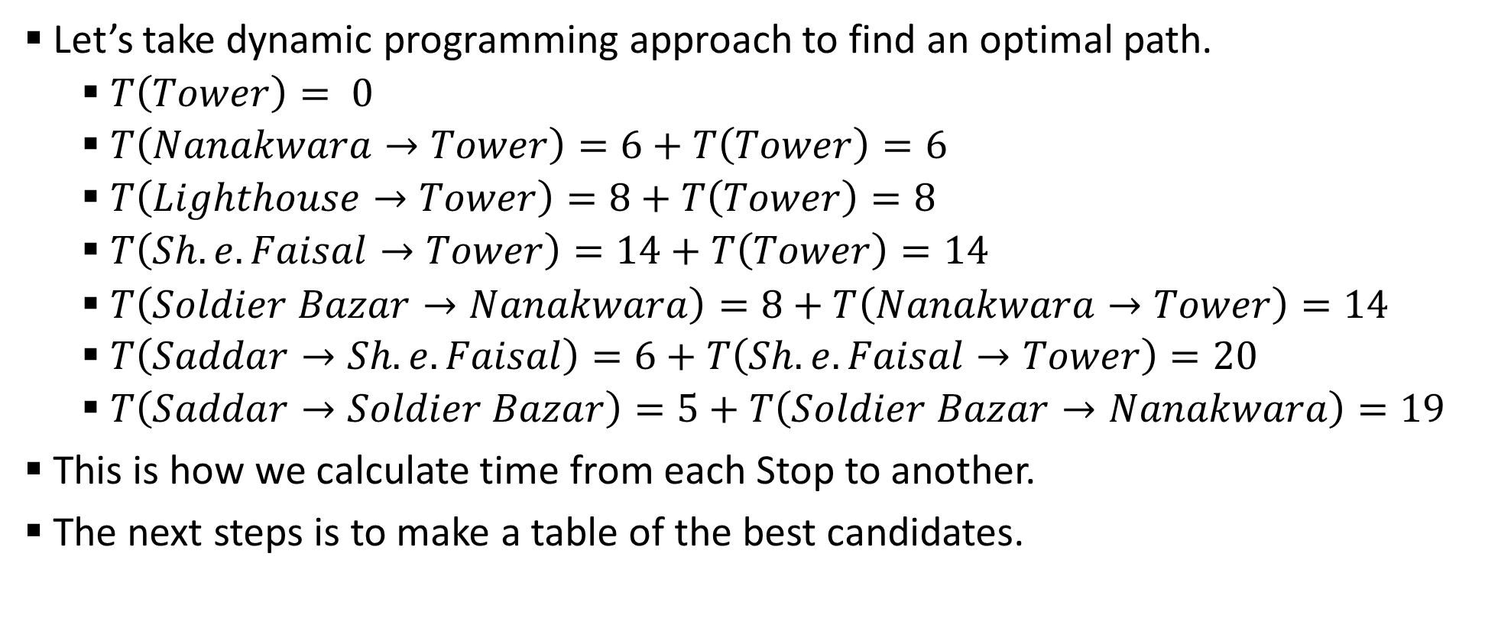
Sample 2
Commute in Karachi
Let’s take dynamic programming approach to find an optimal path.
$T\left(Tower\right)= 0$
$T\left(Nanakwara→Tower\right)=6+T\left(Tower\right)=6$
$T\left(Lighthouse→Tower\right)=8+T\left(Tower\right)=8$
$T\left(Sh.e.Faisal→Tower\right)=14+T\left(Tower\right)=14$
$T\left(Soldier Bazar→Nanakwara\right)=8+T\left(Nanakwara→Tower\right)=14$
$T\left(Saddar→Sh.e.Faisal\right)=6+T\left(Sh.e.Faisal→Tower\right)=20$
$T\left(Saddar→Soldier Bazar\right)=5+T\left(Soldier Bazar→Nanakwara\right)=19$
This is how we calculate time from each Stop to another.
The next steps is to make a table of the best candidates.

Slide 19
Sample 2
Exercise
Can you complete the rest of the table?
Remember to use the equation when there are more than one paths.
 | Water pump | NIPA | Five Star | 3 Hatti | Bahria Uni | Lasbela | Saddar | Soldier Bazar | Sh-e-Faisal | Light house | Nanakwara | Tower
Time |  |  |  |  |  |  | 19 | 14 | 14 | 8 | 6 | 0
Stop |  |  |  |  |  |  | Soldier Bazar | Nanakwara | Tower | Tower | Tower | Tower

Slide 20
Sample 2
Exercise
Once the table is complete, it is easy to calculate the optimal path.
Start from Water Pump and go to its respective destination.
From that destination, go to next. Keep on until you reach Tower.
However, keep in mind that if there is a tie between two stops, note down both.
But where did we apply the Dynamic programming precisely?

Slide 21
Sample 2
Exercise
To answer to that, we need to ask 3 questions:
Is the problem recursive in nature? Yes! Calculating time is dependent on the time from previous stop.
Did we solve a sequence of steps for optimal solution? Yes! We iteratively chose a decision path from the table.
Did we eliminate re-computation of same sub-solution? Yes! Once the time was calculated from one stop to Tower, it was reused.

Slide 22
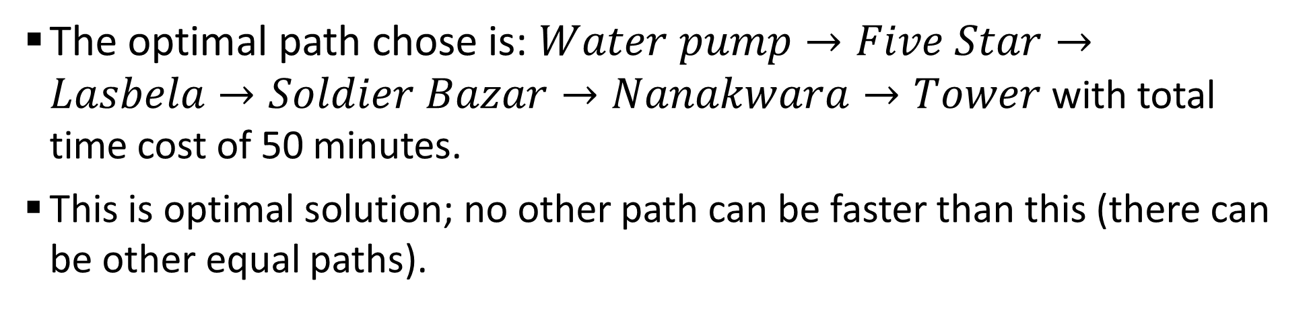
Sample 2
Exercise
Final Table
 | Water pump | NIPA | Five Star | 3 Hatti | Bahria Uni | Lasbela | Saddar | Soldier Bazar | Sh-e-Faisal | Light house | Nanakwara | Tower
Time | 50 | 38 | 40 | 31 | 20 | 24 | 19 | 14 | 14 | 8 | 6 | 0
Stop | NIPA, Five Star | Bahria Uni | Lasbela | Lasbela | Sh-e-Faisal | Soldier Bazar | Soldier Bazar | Nanakwara | Tower | Tower | Tower | Tower
The optimal path chose is: $Water pump→Five Star→Lasbela→Soldier Bazar→Nanakwara→Tower$ with total time cost of 50 minutes.
This is optimal solution; no other path can be faster than this (there can be other equal paths).

Slide 23
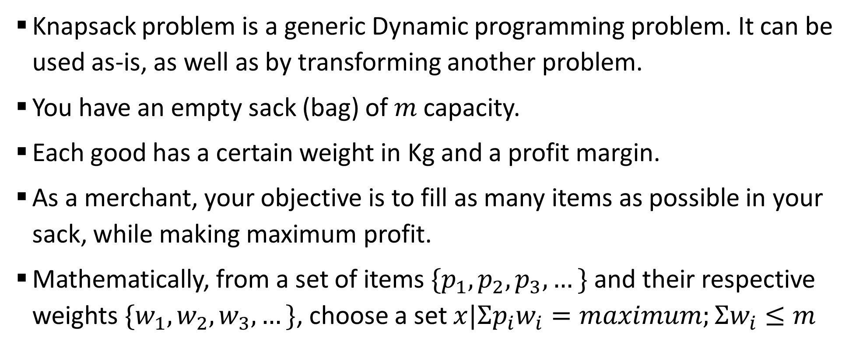
Sample 2
0/1 Knapsack Problem
Knapsack problem is a generic Dynamic programming problem. It can be used as-is, as well as by transforming another problem.
You have an empty sack (bag) of $m$capacity.
Each good has a certain weight in Kg and a profit margin.
As a merchant, your objective is to fill as many items as possible in your sack, while making maximum profit.
Mathematically, from a set of items $\{p_{1},p_{2},p_{3},…\}$ and their respective weights $\{w_{1},w_{2},w_{3},…\}$, choose a set $x|Σp_{i}w_{i}=maximum;Σw_{i}≤m$

Slide 24
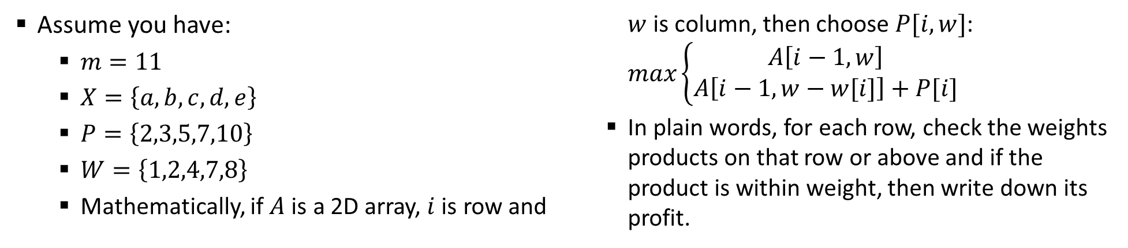
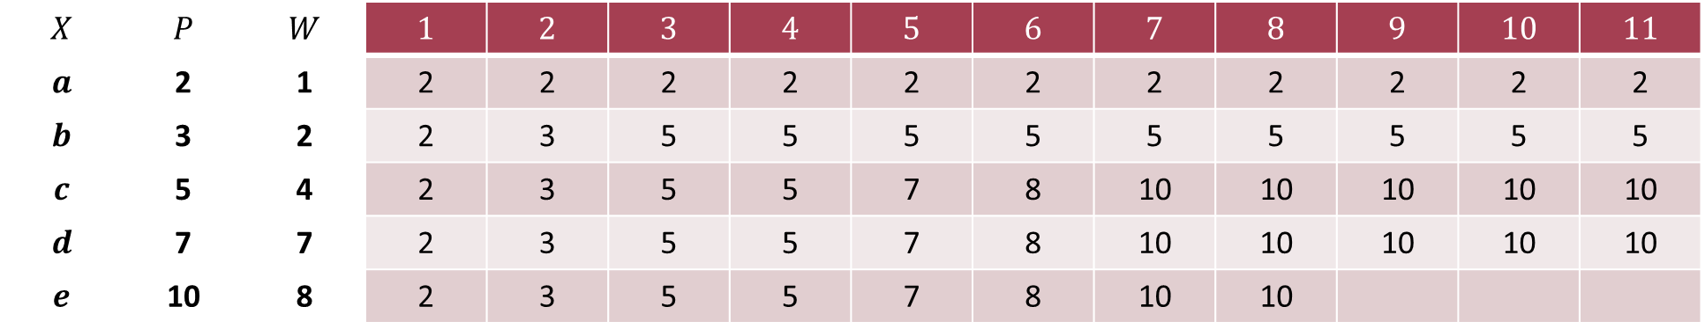
Sample 2
0/1 Knapsack Problem
Assume you have:
$m=11$
$X=\left\{a,b,c,d,e\right\}$
$P=\left\{2,3,5,7,10\right\}$
$W=\left\{1,2,4,7,8\right\}$
Mathematically, if $A$ is a 2D array, $i$ is row and $w$ is column, then choose $P[i,w]$: $max\left\{\begin{aligned}A\left[i−1,w\right] \\ A\left[i−1,w−w[i]\right]+P[i]\end{aligned}\right.$
In plain words, for each row, check the weights products on that row or above and if the product is within weight, then write down its profit.
$$X$$ | $$P$$ | $$W$$ | $$1$$ | $$2$$ | $$3$$ | $$4$$ | $$5$$ | $$6$$ | $$7$$ | $$8$$ | $$9$$ | $$10$$ | $$11$$
$$a$$ | 2 | 1 | 2 | 2 | 2 | 2 | 2 | 2 | 2 | 2 | 2 | 2 | 2
$$b$$ | 3 | 2 | 2 | 3 | 5 | 5 | 5 | 5 | 5 | 5 | 5 | 5 | 5
$$c$$ | 5 | 4 | 2 | 3 | 5 | 5 | 7 | 8 | 10 | 10 | 10 | 10 | 10
$$d$$ | 7 | 7 | 2 | 3 | 5 | 5 | 7 | 8 | 10 | 10 | 10 | 10 | 10
$$e$$ | 10 | 8 | 2 | 3 | 5 | 5 | 7 | 8 | 10 | 10

Slide 25
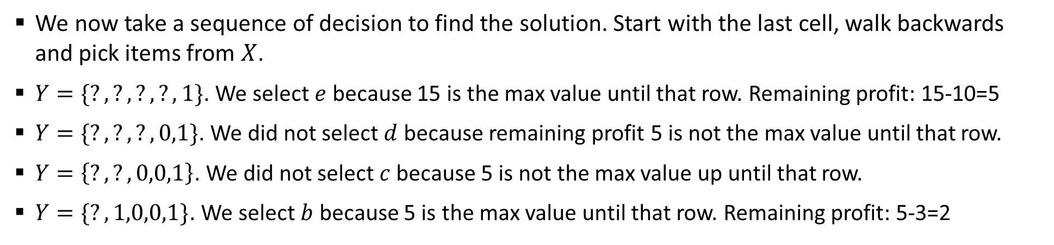

Sample 2
0/1 Knapsack Problem
We now take a sequence of decision to find the solution. Start with the last cell, walk backwards and pick items from $X$.
$Y=\{?,?,?,?,1\}$. We select $e$ because 15 is the max value until that row. Remaining profit: 15-10=5
$Y=\{?,?,?,0,1\}$. We did not select $d$ because remaining profit 5 is not the max value until that row.
$Y=\left\{?,?,0,0,1\right\}$. We did not select $c$ because 5 is not the max value up until that row.
$Y=\{?,1,0,0,1\}$. We select $b$ because 5 is the max value until that row. Remaining profit: 5-3=2
$$X$$ | $$P$$ | $$W$$ | $$1$$ | $$2$$ | $$3$$ | $$4$$ | $$5$$ | $$6$$ | $$7$$ | $$8$$ | $$9$$ | $$10$$ | $$11$$
$$a$$ | 2 | 1 | 2 | 2 | 2 | 2 | 2 | 2 | 2 | 2 | 2 | 2 | 2
$$b$$ | 3 | 2 | 2 | 3 | 5 | 5 | 5 | 5 | 5 | 5 | 5 | 5 | 5
$$c$$ | 5 | 4 | 2 | 3 | 5 | 5 | 7 | 8 | 10 | 10 | 10 | 10 | 10
$$d$$ | 7 | 7 | 2 | 3 | 5 | 5 | 7 | 8 | 10 | 10 | 10 | 12 | 12
$$e$$ | 10 | 8 | 2 | 3 | 5 | 5 | 7 | 8 | 10 | 10 | 12 | 13 | 15

Slide 26
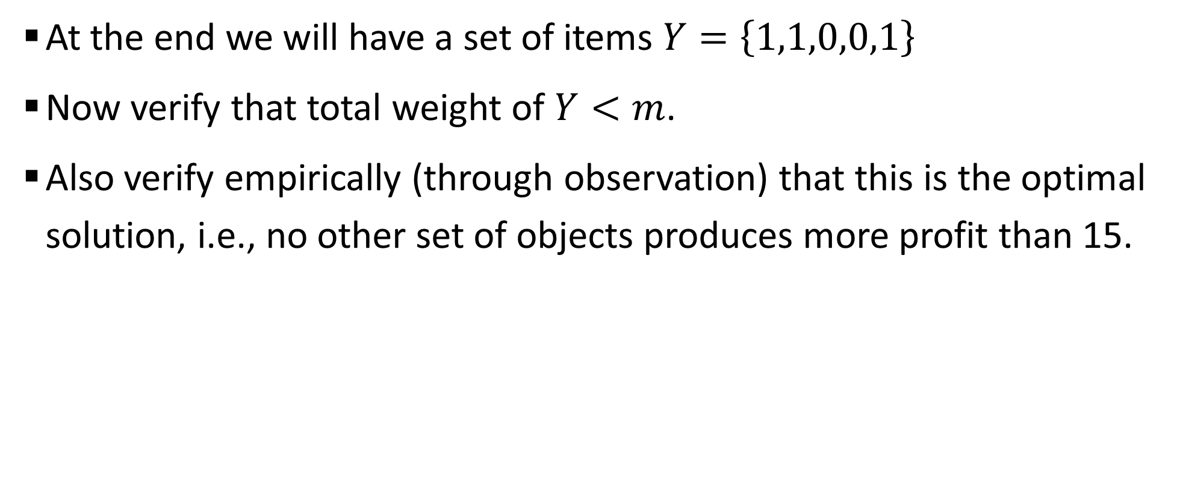
Sample 2
0/1 Knapsack Problem
At the end we will have a set of items $Y=\left\{1,1,0,0,1\right\}$
Now verify that total weight of $Y<m$.
Also verify empirically (through observation) that this is the optimal solution, i.e., no other set of objects produces more profit than 15.

Slide 27
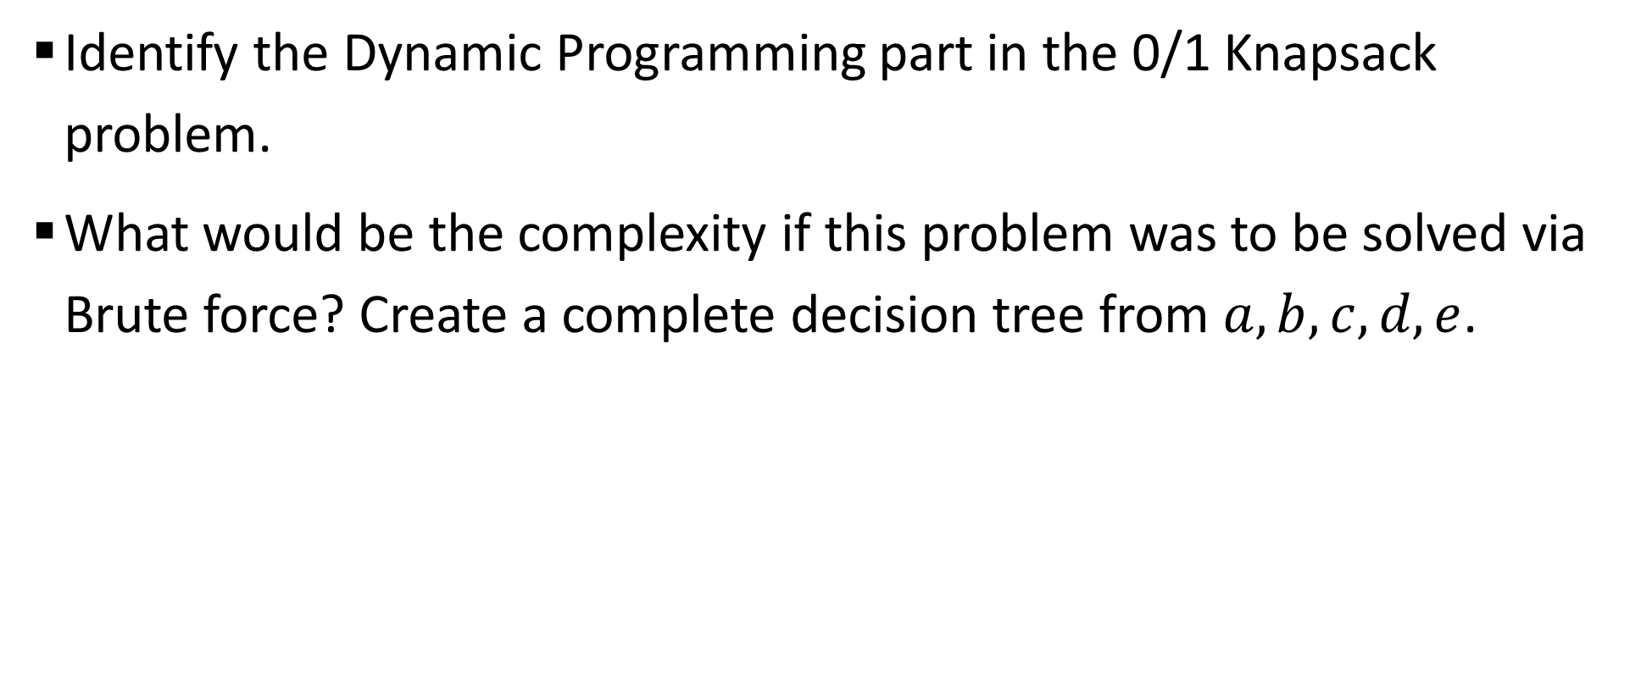
Sample 2
DIY
Identify the Dynamic Programming part in the 0/1 Knapsack problem.
What would be the complexity if this problem was to be solved via Brute force? Create a complete decision tree from $a,b,c,d,e$.

Slide 28



THANK YOU
Owais Hussain
+92 345-3174270
owais.hussain@kiet.edu.pk
https://www.researchgate.net/profile/Owais-Hussain-3

